Slide 1
Lecture on (photonic) fault-tolerant quantum computing
Paul Hilaire

Slide 2
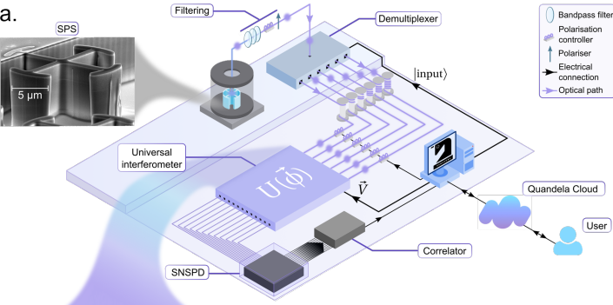
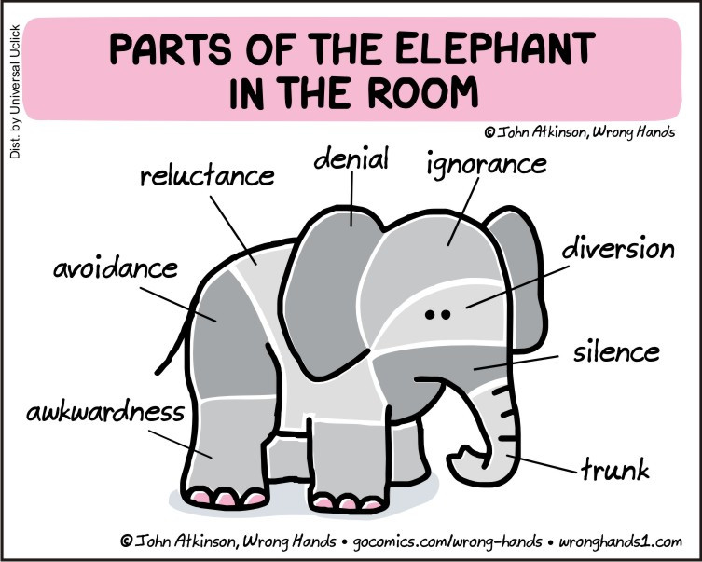
Why do we need fault-tolerant quantum computing?
The inconvenient truth about NISQ…
Current architecture at Quandela
Why is it great?
Photon-native operations
1 qubit = 1 photon
Fast repetition rate
Good for NISQ algorithms
Single-photon
source
Classical
control
Linear-optical
interferometer
Detectors
N. Maring et al., Arxiv 2306.00684 (2023)
Errors… How bad are these?

Slide 3
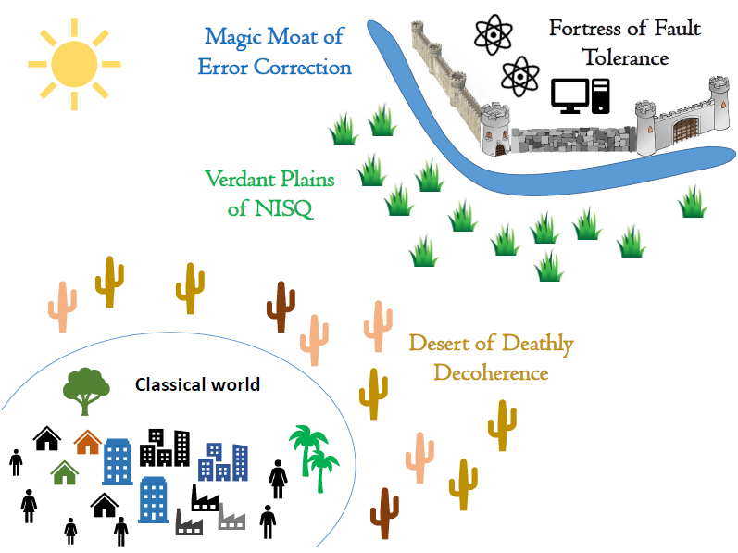
Why do we need fault-tolerant quantum computing?
The inconvenient truth about NISQ…
QC useful
Applications!
Reducing noise!
NISQ useful
applications?
Quantum advantage
Credit: Entropica Labs

Slide 4
Why do we need fault-tolerant quantum computing?
The inconvenient truth about NISQ…
Current architecture at Quandela
Why is it great?
Photon-native operations
1 qubit = 1 photon
Fast repetition rate
Good for NISQ algorithms
Why do we need to improve it?
Errors…
Photon loss
Multi-photon emission
Photon distinguishability
How bad are these?

Slide 5
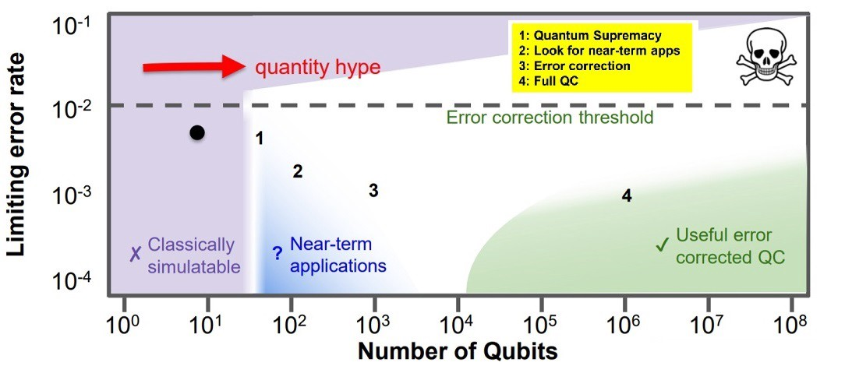
Why do we need Fault-tolerant quantum computing?
Errors are bad
How bad are these errors?
Quantum error correction!
Hardware:
Reducing physical noises
$$ε≪1$$
Software:
Developing a FTQC-based architecture
Threshold theorem:
if $ε<ε_{th}$, we can run any algorithms!
(provided the FTQC is sufficiently big!)
Shor
Credit: Google
Shor
Without handling errors
$→$ Only the tip of the Q Algo’s iceberg!

Slide 6
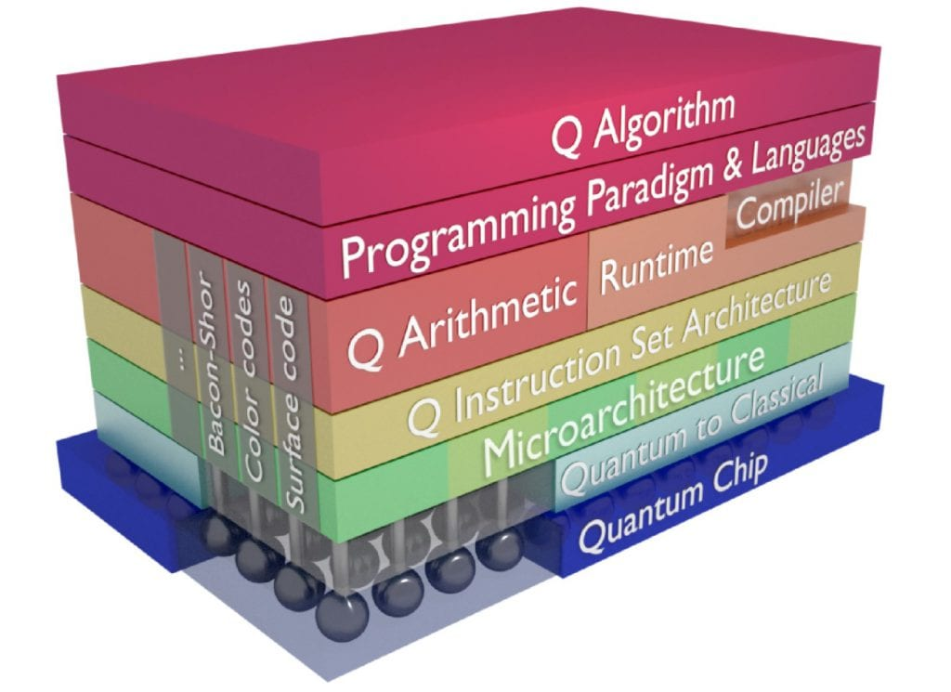
Architecture for real Fault-tolerant quantum computers
Find the best FTQC architecture for a photonic platform
What is an FTQC architecture?
A method to process quantum information
Together with a hardware layout enabling this method
All of this being achievable in a fault-tolerant way
Detector
What is the “best” architecture?
An architecture with maximum fault-tolerance (high threshold)
A relatively simple hardware layout (sufficiently simple to be implementable)
An architecture with relatively small footprint (hardware overhead, energy consumption…)
$$η_{d}$$
$$η=η_{s}{η_{t}η}_{d}$$

Slide 7
Outline
Classical error correction
Repetition code / Hamming code
Quantum error correction
Challenges of quantum error correction
Discretization of errors
Stabilizer formalism
Simple code (Shor)
Photonic FTQC
Graph state structure
How to build them?
Detector
$$η_{d}$$
$$η=η_{s}{η_{t}η}_{d}$$

Slide 8
Classical Error Correction

Slide 9
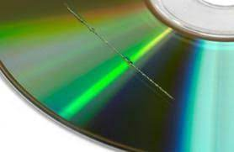
Simple examples of classical error correction
Classical computing using classical error correction
Simple examples of classical error correction:
CD Rom
Communication protocols (e.g. 5G)
General idea:
$$\left[n, k,d\right]$$
“Encode $k$ logical (protected) bits into $n$ physical (noisy) bits so that it is protected against $\left\lfloor d−1\right\rfloor /2$ bitflips”

Slide 10
The Repetition Code
Classical computing using classical error correction
The repetition code is a $[n, 1, n]$ code with a trivial decoder (majority vote)
The logical bit $i=0$ or 1 is encoded as
$0_{L}=0…0$
$1_{L}=1…1$
How does it work?
If you receive the bitstring (encoded using a 3-bit repetition code) $010$, what is the most likely error?
Assuming independent symmetric errors (below ½), the most likely error is e=010 and the codeword is $0_{L} = 000$

Slide 11
Simpler example with classical error correction
Classical computing using classical error correction
Hamming code:
Encode 4 logical bits $l_{1}l_{2}l_{3}l_{4}$
Into 7 physical bits $b_{1}b_{2}b_{3}b_{4}b_{5}b_{6}b_{7}$
$$b_{5}$$
Circle constraints $⊕_{i}b_{i}=0$
$$b_{1}$$
$$b_{2}$$
$$b_{4}$$
$$H=\left(\begin{matrix}1 \\ 1 \\ 0\end{matrix} \begin{matrix}1 & 0 & 1 \\ 0 & 1 & 1 \\ 1 & 1 & 1\end{matrix} \begin{matrix}1 & 0 & 0 \\ 0 & 1 & 0 \\ 0 & 0 & 1\end{matrix}\right)$$
$$b_{6}$$
$$b_{3}$$
$$b_{7}$$

Slide 12
Simpler example with classical error correction
Classical computing using classical error correction
Hamming code:
Encode 4 logical bits $l_{1}l_{2}l_{3}l_{4}$
Into 7 physical bits $b_{1}b_{2}b_{3}b_{4}b_{5}b_{6}b_{7}$
$$b_{5}$$
Circle constraints $⊕_{i}b_{i}=0$
$$b_{1}$$
$$b_{2}$$
Invalid codeword $c=c_{1}c_{2}c_{3}c_{4}c_{5}c_{6}c_{7}$
Syndrome $s=H c^{T}≠0$
Example: $H c^{T}≠{\left(0,1, 1\right)}^{T}$
$$b_{4}$$
$$b_{6}$$
$$b_{3}$$
$$b_{7}$$

Slide 13
Simpler example with classical error correction
Classical computing using classical error correction
General problem of error correction:
“Given a syndrome $s$, recover ideally the most likely error that outputs a syndrome $s$”
$$"c^{T}=H^{−1}s“$$
$$b_{5}$$
Given an error sampling probability $p (e_{i})$,
We want (ideally):
$$MLDec\left(p\left(e_{i}\right),s\right)$$
$$= {argmin}_{e_{i}} \left[p\left(e_{i}\right)\right|H e_{i}=s]$$
$$b_{1}$$
$$b_{2}$$
$$b_{4}$$
$$b_{6}$$
$$b_{3}$$
$$b_{7}$$
What is the most likely error, having this syndrome?
Assuming independent symmetric errors (below ½), the most likely error is a $b_{3}$ bitflip only

Slide 14
General summary of classical error correction
Classical computing using classical error correction
$$c$$
$$c+e$$
Syndrome extraction
($He=s$)
$$c+e$$
Correction
$$c+e+\hat{e}$$
Noise
($e$)
$$\hat{e}$$
Decoding
Successful decoding
$$c+e+\hat{e}=c$$
$$e+\hat{e}=0$$
$$s$$

Slide 15
That’s all for Classical Error Correction.
Questions?

Slide 16
Quantum Error Correction
(intuition)

Slide 17
Challenges of Quantum error correction
Why isn’t it conceptually easy?
Challenge 1:
Errors in classical computing are discrete.
Errors in quantum computing are continuous…
Challenge 2:
Measuring a classical bit is trivial.
Measuring a quantum state destroy this state (Born’s rule / Wave function collapse…)
Challenge 3:
Classical error correction needs to protect against bitflips
In quantum computing, the phase is also important!

Slide 18
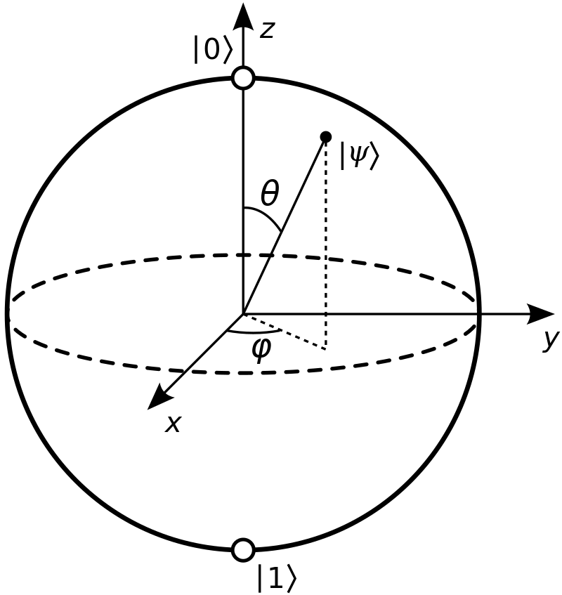
Errors are continuous…
Why isn’t it conceptually easy?
Qubit: $\left|ψ\left(θ, φ\right)\right\rangle =\cos{\frac{θ}{2}}\left|0\right\rangle +e^{iφ} sin{\frac{θ}{2}}|1⟩$
Target state: $\left|0\right\rangle$
Noisy state: $\sqrt{1 −ε}\left|0\right\rangle +\sqrt{ε} |1⟩$
Measurement in the computational basis
( $|0⟩$ / $|1⟩$)
$→$ $|0⟩$ with probability $1 −ε$
$→$ $|1⟩$ with probability $ε$
Intuition 1: Errors are continuous but measurements discretize these errors

Slide 19
Measurements destroy quantum states and entanglement
Why isn’t it conceptually easy?
Entangled qubits:
$\frac{1}{\sqrt{2}}(\left|00\right\rangle +|11⟩)$
Is it true for all measurements???
Measurement of the operator $ZZ$
$Z\left|i\right\rangle ={\left(−1\right)}^{i}\left|i\right\rangle$ for $i=0,1$
What are the measurement outcomes and the resulting states?
Same question for $\frac{1}{\sqrt{2}}(\left|00\right\rangle −|11⟩)$?
Measurement of the two qubits in the computational basis ($Z basis)$
( $|0⟩$ / $|1⟩$)
$→$ $|0⟩$, $|0⟩$ with probability $\frac{1}{2}$
$→$ $|1⟩$, $|1⟩$ with probability $\frac{1}{2}$
No entanglement anymore…
+1 for both and the state remains the same
Intuition 2: Some multi-qubit operator measurements preserve entanglement and some states.

Slide 20
Repetition codes for quantum states
Why isn’t it conceptually easy?
$${\left|ψ\right\rangle }_{L}=α{\left|0\right\rangle }_{L}+β{\left|1\right\rangle }_{L}$$
With ${\left|0\right\rangle }_{L}=\left|000\right\rangle ,$ ${\left|1\right\rangle }_{L}=\left|111\right\rangle$
Noise:
Some small unwanted $X$ rotations on the physical qubits…
$$\left|\tilde{ψ_{L}}\right\rangle =\sqrt{1−ε} {\left|ψ\right\rangle }_{L} \\ +\sqrt{ε/3}\left(α\left|100\right\rangle +β\left|011\right\rangle \right) \\ +\sqrt{ε/3}\left(α\left|010\right\rangle +β\left|101\right\rangle \right) \\ +\sqrt{ε/3}\left(α\left|001\right\rangle +β\left|110\right\rangle \right)+o(ε)$$
Measure $Z_{1}Z_{2}$ (+1 outcome and nothing happens)
Measure $Z_{2}Z_{3}$
- either +1 outcome and projection in the ${\left|ψ\right\rangle }_{L}$ state.
- either -1 outcome and error detection
$$α|001⟩+β|110⟩$$
We have obtained the syndrome measurement s=(0, 1)
Link with the parity check matrix?

Slide 21
Repetition codes for quantum states
Why isn’t it conceptually easy?
$$\left|ψ_{L}\right\rangle$$
$$|\tilde{ψ_{L}}⟩$$
Syndrome extraction (Measurement $Z_{1}Z_{2}$, $Z_{2}Z_{3}$)
$$|\tilde{ψ_{L}}⟩$$
Correction
$$\left|ψ_{L}\right\rangle +o(ε)$$
Noise
($ε$)
$$X_{3}$$
Decoding
$$s$$
(measurement outcomes)
What about phase flips?

Slide 22
The Shor code
Why isn’t it conceptually easy?
$${\left|ψ\right\rangle }_{L}=α{\left|0\right\rangle }_{L}+β{\left|1\right\rangle }_{L}$$
With ${\left|0\right\rangle }_{L}=\left|000\right\rangle ,$ ${\left|1\right\rangle }_{L}=\left|111\right\rangle$
Noise:
Some small unwanted $Z$ rotations on the physical qubits…
$$\left|\tilde{ψ_{L}}\right\rangle =\sqrt{1−ε} {\left|ψ\right\rangle }_{L} \\ +\sqrt{ε} (α\left|000\right\rangle −β|111⟩)$$
Alternative code
$${\left|ψ\right\rangle }_{L}=α{\left|0\right\rangle }_{L}+β{\left|1\right\rangle }_{L}$$
With ${\left|0\right\rangle }_{L}=\left|+++\right\rangle ,$ ${\left|1\right\rangle }_{L}=\left|−−−\right\rangle$
$$\left|±\right\rangle =\frac{1}{\sqrt{2}}\left(\left|0\right\rangle ± | 1\right\rangle ))$$
Show that it is resistant against phase flips (Z).
What is the operator measurements?
Still a valid logical state!
$→$Impossible to correct a phase flip…
$$X \left|±\right\rangle =±|±⟩$$
Same discussion as in the usual repetition code, but with $X_{1}X_{2}$ operator measurements

Slide 23
The Shor code
Why isn’t it conceptually easy?
Concatenating two repetition codes!
${\left|0\right\rangle }_{L_{Z}}=\left|000\right\rangle ,$ ${\left|1\right\rangle }_{L_{Z}}=\left|111\right\rangle$
${\left|0\right\rangle }_{L_{X}}=\left|+++\right\rangle ,$ ${\left|1\right\rangle }_{L_{X}}=\left|−−−\right\rangle$
Concatenation: Replace physical qubits from the first code $L_{1}$ by logical qubits from the second code.
Shor code:
${\left|0\right\rangle }_{Shor}=|+_{L_{Z}}+_{L_{Z}}+_{L_{Z}}⟩,$ ${\left|1\right\rangle }_{Shor}=\left|−_{L_{Z}}−_{L_{Z}}−_{L_{Z}}\right\rangle$
At the $L_{X}$ levels, correct one phase flip, at the $L_{Z}$ level, correct one bit flip.
What about $Y=−iZX$ rotation errors?
$${\left|±\right\rangle }_{L_{Z}}=\left|000\right\rangle ±\left|111\right\rangle$$

Slide 24
The Shor code
Why isn’t it conceptually easy?
$$α{\left|0\right\rangle }_{Shor}+β{\left|1\right\rangle }_{Shor}={α\left(\left|000\right\rangle +\left|111\right\rangle \right)}^{⊗3}+{ β\left(\left|000\right\rangle −\left|111\right\rangle \right)}^{⊗3}$$
If an $X$ error occur on one qubit, one block will look like $\left|001\right\rangle ±\left|110\right\rangle ,$ (modulo where the bit flip occurs) which can be corrected by $Z_{1}Z_{2}/Z_{2}Z_{3}$ in that block.
If a $Z$ error occurs on one qubit, one qubit block will be flipped:
$$α(\left|000\right\rangle +|111⟩)\text{(}\left|000\right\rangle +|111⟩)(\left|000\right\rangle −|111⟩)$$
$$+β(\left|000\right\rangle −|111⟩)\text{(}\left|000\right\rangle −|111⟩)(\left|000\right\rangle +|111⟩)$$
Which can be detected by measuring logical $X_{L_{1}}X_{L_{2}}/X_{L_{2}}X_{L_{3}}$operator on each block $X_{L_{1}}=X_{1}X_{2}X_{3},X_{L_{2}}=X_{4}X_{5}X_{6}$, $X_{L_{3}}=X_{7}X_{8}X_{9}$

Slide 25
The Shor code
Why isn’t it conceptually easy?
$$α{\left|0\right\rangle }_{Shor}+β{\left|1\right\rangle }_{Shor}={α\left(\left|000\right\rangle +\left|111\right\rangle \right)}^{⊗3}+{ β\left(\left|000\right\rangle −\left|111\right\rangle \right)}^{⊗3}$$
If a Y error occurs on a given qubit, it’ll flip both a qubit on a given block and the total block sign which can be signaled by having the X and Z errors at the same time
$$Y_{1}\left(\left|000\right\rangle ±\left|111\right\rangle \right)=−iZX\left(\left|000\right\rangle ±\left|111\right\rangle \right)=−i\left|100\right\rangle ∓|011⟩$$
(The global phase $i$ is irrelevant)
So a $Y$ error can be corrected as a combination of $X$ and $Z$ error.

Slide 26
Summary of the intuitions
Why isn’t it conceptually easy?
Measurements discretize errors
Measurements of multi-qubit operators can sometimes preserve entanglement
Some multi-qubit operators allows the detection of a bit flip or a phase flip.
The multi-qubit operators should preserve the logical states
Can we generalize these ideas?
How does it work in practice?

Slide 27
Quantum Error Correction
(beyond intuition)

Slide 28
The stabilizer formalism
Why isn’t it conceptually easy?
Some definitions
Pauli operators:
$$\begin{matrix}I=σ_{0}=\left(\begin{matrix}1 & 0 \\ 0 & 1\end{matrix}\right) & X=σ_{1}=\left(\begin{matrix}0 & 1 \\ 1 & 0\end{matrix}\right) \\ Y=σ_{2}=\left(\begin{matrix}0 & −i \\ i & 0\end{matrix}\right) & Z=σ_{3}=\left(\begin{matrix}1 & 0 \\ 0 & −1\end{matrix}\right)\end{matrix}$$
$P_{1}= \left\langle iI, X, Z\right\rangle =\left\{±1, ±i\right\}×\left\{I, X, Y, Z\right\}$ has a group structure and is called the single-qubit Pauli group.
$P_{n}=P_{1}^{⊗n}$ is the $n$-qubit Pauli group, and we call its elements “Pauli strings”.

Slide 29
The stabilizer formalism
The theoretical framework of QEC
We are interested in Pauli string operators that “stabilizes” a quantum state and we call these operators “stabilizers”.
$K$ stabilizes $|ψ⟩$ if $K \left|ψ\right\rangle = +1|ψ⟩$
We are interested in Pauli string operators that “stabilizes” a quantum state and we call these operators “stabilizers”.
$K$ stabilizes $|ψ⟩$ if $K \left|ψ\right\rangle = +1|ψ⟩$
What are the stabilizers of $|0⟩$ ?
$$\left\{I, Z\right\}$$
What are the stabilizers of $\left|1\right\rangle$?
$$\left\{I, −Z\right\}$$
What are the stabilizers of $\frac{1}{\sqrt{2}}(\left|00\right\rangle +|11⟩)$ ?
$$\left\{II, ZZ, XX, −YY\right\}$$
What are the stabilizers of $α\left|00\right\rangle +β|11⟩$ $∀α, β$ ?
$$\left\{I, ZZ\right\}$$

Slide 30
The stabilizer formalism
The theoretical framework of QEC
A n-qubit quantum state is stabilized by $2^{n}$ operators.
Its stabilizer operators have an abelian group structure.
ex. $\left|00\right\rangle +|11⟩$ stabilized by $\{II, XX, ZZ, −YY\}$
The stabilizer group of $2^{n}$ elements have $n$ linearly independent generators
ex. $\{II, XX, ZZ, −YY\}$ is generated by $⟨XX, ZZ⟩$
($XX ZZ=−YY, XX XX=II)$
A stabilizer group of $n−k$ ($n$-qubit) Pauli strings generators, stabilizes a $k$-qubit Hilbert subspace (in a $n$-qubit Hilbert space)
ex. $\{II, ZZ\}$ stabilizes $α\left|00\right\rangle +β\left|11\right\rangle =α{\left|0\right\rangle }_{L}+β{\left|1\right\rangle }_{L}$ (with $\left|ii\right\rangle ={\left|i\right\rangle }_{L}$)

Slide 31
Link with quantum error correction
The theoretical framework of QEC
A $[\left[n,k,d\right]]$ Quantum Error Correcting code encode $k$ logical qubits into $n$ physical qubits to protect quantum information against $\left\lfloor (d−1)/2\right\rfloor$ errors.
Syndrome through parity check measurement
$$H_{X}e_{X} = s_{X},$$
$$H_{Z}e_{Z} = s_{Z}$$
The stabilizer formalism gives you a way to encode a $k$-qubit Hilbert subspace into a $n$-qubit Hilbert space with constraints given by stabilizer operators.
Stabilizer group generated by:
$$\left\langle K_{1}, …K_{n−k}\right\rangle$$
$$K_{i}{\left|\tilde{ψ}\right\rangle }_{L}={\left(−1\right)}^{s_{i}} {\left|\tilde{ψ}\right\rangle }_{L}$$
$$\frac{{1−⟨\tilde{ψ}{\left.​\right|}_{L}K}_{i}{\left|\tilde{ψ}\right\rangle }_{L}}{2}=s_{i}$$
If $∃i, s_{i}=1$, an error is detected

Slide 32
Link / challenges: classical and quantum error correction
Calderbank-Steane-Shor codes
Classical codes protects against bitflips: $He=s$
We can create quantum codes that protects against blitflips using $H→K_{Zi}$s, $Z$-type stabilizers
$$H=\left(\begin{matrix}1 & 1 & 0 \\ 0 & 1 & 1\end{matrix}\right)→\begin{matrix}Z_{1}Z_{2}I_{3} \\ I_{1}Z_{2}Z_{3}\end{matrix}, H_{Z}$$
We can create quantum codes that protects against phaseflips using $H→K_{Xi}$s, $X$-type stabilizers
$$H=\left(\begin{matrix}1 & 1 & 0 \\ 0 & 1 & 1\end{matrix}\right)→\begin{matrix}X_{1}X_{2}I_{3} \\ I_{1}X_{2}X_{3}\end{matrix}, H_{X}$$

Slide 33
Link / challenges: classical and quantum error correction
Calderbank-Steane-Shor codes
How to make codes that protects against phaseflips and bitflips?
Use two classical codes $H_{X}$, $H_{Z}$! $⟨K_{X1,}…K_{Xn,}K_{Z1,}…K_{Zm}⟩$
Can we do always that?
The stabilizer groups protect a qubit subspace
The stabilizer group should be abelian $\left[K_{Xi}, K_{Zj}\right]=0$
Show that this constraint requires $H_{X}.H_{Z}^{T}=0$?
Not so easy to find such conditions!

Slide 34
Link / challenges: classical and quantum error correction
Calderbank-Steane-Shor codes
Relate stabilizers to $H_{X}$ and $H_{Z}$ matrices:
The $i^{th}$row of $H_{X}$ corresponds to $K_{Xi}$:
Notations: ${\left(H_{X}\right)}_{ij}=h_{ij}^{X}$ , ${\left(H_{Z}\right)}_{ij}=h_{ij}^{Z}$
$X^{0}=I, X^{1}=X$,
$X_{j}^{h_{ij}^{X}}=I_{i}$ if$h_{ij}^{X}=0$,
$X_{j}^{h_{ij}^{X}}=X_{i}$ if$h_{ij}^{X}=1$
So: $K_{Xi}=\prod_{j}{X_{j}^{h_{ij}^{X}}}$
Same for $H_{Z}:K_{Zi}=\prod_{j}{Z_{j}^{h_{ij}^{Z}}}$

Slide 35
Link / challenges: classical and quantum error correction
Calderbank-Steane-Shor codes
Commutation relations: $\left[K_{Xi},K_{Zi^{′}}\right]=0$
if $\prod_{j}{\left(X_{j}^{h_{ij}^{X}}Z_{j}^{h_{i^{′}j}^{Z}}\right)}=\prod_{j}{\left(Z_{j}^{h_{i^{′}j}^{Z}}X_{j}^{h_{ij}^{X}}\right)}$
$X^{h_{ij}^{X}}Z^{h_{i′j}^{Z}}=Z^{h_{i′j}^{Z}}X^{h_{ij}^{X}}$ if $h_{ij}^{X}=0$, or $h_{i′j}^{Z}=0$ (at least one is I)
$X^{h_{ij}^{X}}Z^{h_{i′j}^{Z}}=−Z^{h_{i′j}^{Z}}X^{h_{ij}^{X}}$if $h_{ij}^{X}=h_{i′j}^{Z}=1$
So $X^{h_{ij}^{X}}Z^{h_{i′j}^{Z}}$= ${\left(−1\right)}^{h_{ij}^{X}×h_{ij}^{Z}} Z^{h_{i′j}^{Z}}X^{h_{ij}^{X}}$
So $\prod_{j}{(X^{h_{ij}^{X}}Z^{h_{i′j}^{Z}})}={\left(−1\right)}^{\sum_{j}{h_{ij}^{X}×h_{i′j}^{Z}}}$ $\prod_{j}{Z^{h_{i′j}^{Z}}X^{h_{ij}^{X}}}$
And the operators commute if the two rows have value 1 on an even number of elements.
We can see this is true for all rows if $H_{X}.H_{Z}^{T}=0$

Slide 36
Simple example with quantum error correction
Calderbank-Steane-Shor codes
Steane quantum code:
Circle constraints $⊗_{i}X_{i}|ψ⟩=|ψ⟩$
Second constraints $⊗_{i}Z_{i}|ψ⟩=|ψ⟩$
$$b_{5}$$
$$b_{1}$$
$$b_{2}$$
Define two parity check matrices
$$H_{X} c_{X}^{T}=0$$
$$H_{Z} c_{Z}^{T}=0$$
CSS codes:
$$H_{X}H_{Z}^{T}=0$$
$$b_{4}$$
$$b_{6}$$
$$b_{3}$$
$$b_{7}$$

Slide 37
The Steane Code
Calderbank-Steane-Shor codes
Steane quantum code:
Circle constraints $⊗_{i}X_{i}|ψ⟩=|ψ⟩$ ($H =H_{X}$)
Second constraints $⊗_{i}Z_{i}\left|ψ\right\rangle =\left|ψ\right\rangle \text{(}H =H_{Z}\text{)}$
$$b_{5}$$
$$b_{1}$$
$$b_{2}$$
$$b_{4}$$
$$H=\left(\begin{matrix}1 \\ 1 \\ 0\end{matrix} \begin{matrix}1 & 0 & 1 \\ 0 & 1 & 1 \\ 1 & 1 & 1\end{matrix} \begin{matrix}1 & 0 & 0 \\ 0 & 1 & 0 \\ 0 & 0 & 1\end{matrix}\right)$$
This works since:
$$H H^{T}=0$$
$$b_{6}$$
$$b_{3}$$
$$b_{7}$$

Slide 38
How to measure stabilizer operators?
Ancilla-assisted stabilizer measurements
Rule of thumb:
Multi-qubit operators are hard to measure. Single-qubit operators are easy to measure.
Strategy: Convert a multi-qubit operator measurement into a single-qubit measurement.
$$\left|0\right\rangle$$
$$|1⟩$$
Always this outcome
Ancilla:$|0⟩$
$$M_{Z}$$

Slide 39
How to measure stabilizer operators?
Ancilla-assisted stabilizer measurements
Rule of thumb:
Multi-qubit operators are hard to measure. Single-qubit operators are easy to measure.
Strategy: Convert a multi-qubit operator measurement into a single-qubit measurement.
CNOT flip the ancilla qubit if qb 1 in state $|1⟩$
Qubit 1
$$\left|0\right\rangle$$
$$|1⟩$$
Ancilla:$|0⟩$
$$M_{Z}$$

Slide 40
How to measure stabilizer operators?
Ancilla-assisted stabilizer measurements
Rule of thumb:
Multi-qubit operators are hard to measure. Single-qubit operators are easy to measure.
Strategy: Convert a multi-qubit operator measurement into a single-qubit measurement.
CNOT flip the ancilla qubit if qb 1 in state $|1⟩$
$$\left|0\right\rangle$$
or
$$|1⟩$$
$$α\left|0\right\rangle$$
$$β|1⟩$$
Qubit 1
$$α\left|0, 0\right\rangle$$
$$β|1, 1⟩$$
$$\left|0\right\rangle$$
$$|1⟩$$
Indirect measurement of qubit 1 (using ancilla) in the $Z$ basis
Ancilla:$|0⟩$
$$M_{Z}$$

Slide 41
How to measure stabilizer operators?
Ancilla-assisted stabilizer measurements
Rule of thumb:
Multi-qubit operators are hard to measure. Single-qubit operators are easy to measure.
Strategy: Convert a multi-qubit operator measurement into a single-qubit measurement.
CNOT flip the ancilla qubit if qb 1 in state $|1⟩$
Qubit 1
$$\left|0\right\rangle$$
$$|1⟩$$
Indirect measurement of qubit 1 (using ancilla) in the $Z$ basis
Ancilla:$|0⟩$
$$M_{Z}$$

Slide 42
How to measure stabilizer operators?
Ancilla-assisted stabilizer measurements
Rule of thumb:
Multi-qubit operators are hard to measure. Single-qubit operators are easy to measure.
Strategy: Convert a multi-qubit operator measurement into a single-qubit measurement.
Qubit 2
Qubit 1
$$\left|0\right\rangle$$
$$|1⟩$$
Ancilla:$|0⟩$
$$M_{Z}$$

Slide 43
How to measure stabilizer operators?
Ancilla-assisted stabilizer measurements
Rule of thumb:
Multi-qubit operators are hard to measure. Single-qubit operators are easy to measure.
Strategy: Convert a multi-qubit operator measurement into a single-qubit measurement.
$$α\left|00\right\rangle +β\left|01\right\rangle +γ\left|10\right\rangle +δ|11⟩$$
$$α\left|00\right\rangle +δ\left|11\right\rangle$$
or
$$β\left|01\right\rangle +γ\left|10\right\rangle$$
Qubit 2
Qubit 1
$$\left|0\right\rangle \left(α\left|00\right\rangle +δ\left|11\right\rangle \right)$$
$$|1⟩(β\left|01\right\rangle +γ\left|10\right\rangle )$$
$$\left|0\right\rangle$$
$$|1⟩$$
Ancilla:$|0⟩$
$$M_{Z}$$

Slide 44
How to measure stabilizer operators?
Ancilla-assisted stabilizer measurements
Rule of thumb:
Multi-qubit operators are hard to measure. Single-qubit operators are easy to measure.
Strategy: Convert a multi-qubit operator measurement into a single-qubit measurement.
Qubit 2
Qubit 1
$$\left|0\right\rangle$$
$$|1⟩$$
Indirect measurement of qubit 1 and 2 (using ancilla) in the $ZZ$ basis
Ancilla:$|0⟩$
$$M_{Z}$$

Slide 45
How to measure stabilizer operators?
Ancilla-assisted stabilizer measurements
Rule of thumb:
Multi-qubit operators are hard to measure. Single-qubit operators are easy to measure.
Strategy: Convert a multi-qubit operator measurement into a single-qubit measurement.
$$H =\frac{1}{\sqrt{2}}\left(\begin{matrix}1 & 1 \\ 1 & −1\end{matrix}\right)$$
$$HXH=Z$$
$$HZH=X$$
Qubit 2
H
H
Qubit 1
H
H
$$\left|0\right\rangle$$
$$|1⟩$$
Indirect measurement of qubit 1 and 2 (using ancilla) in the $XX$ basis
Ancilla:$|0⟩$
$$M_{Z}$$

Slide 46
How to measure stabilizer operators?
Ancilla-assisted stabilizer measurements
Rule of thumb:
Multi-qubit operators are hard to measure. Single-qubit operators are easy to measure.
Strategy: Convert a multi-qubit operator measurement into a single-qubit measurement.
Qubit 4
Qubit 3
Qubit 2
Qubit 1
$$\left|0\right\rangle$$
$$|1⟩$$
Indirect $ZZZZ$measurement
Ancilla:$|0⟩$
$$M_{Z}$$

Slide 47
What is quantum error correction?
A fault-tolerant quantum computer use a QEC code and QEC detection cycles to actively detect and correct errors, using ancilla qubits.
Noise / errors
$$×n$$
Logical state ${\left|ψ\right\rangle }_{L}$
$${\left|ψ\right\rangle }_{L}$$
Entangle
Correct
Detector
$$η_{d}$$
Ancillas $|0…0 ⟩$
Measure
ancillas
Decode
$$η=η_{s}{η_{t}η}_{d}$$
Error correction cycle

Slide 48
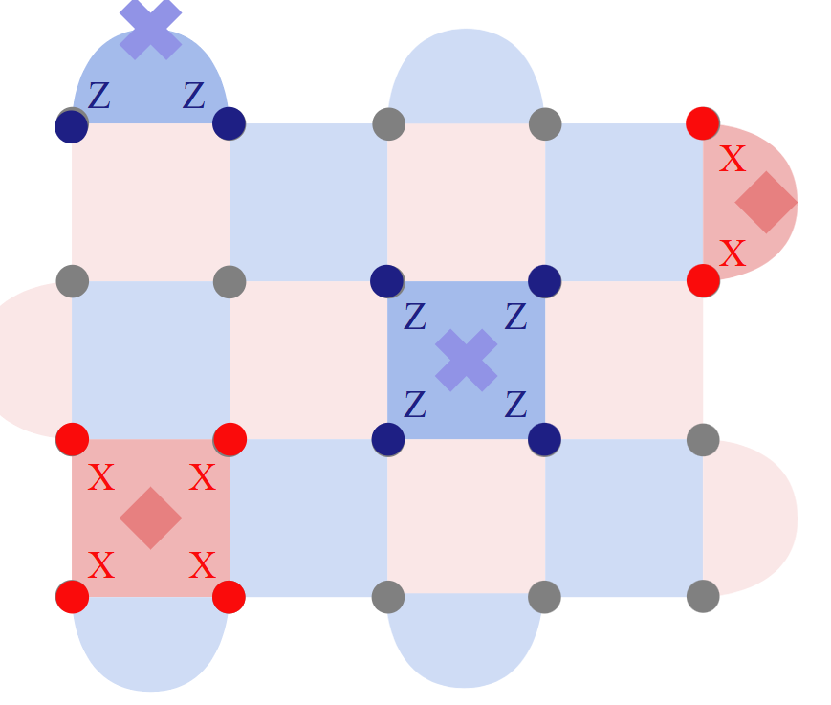
More advanced codes
Quantum circuit for stabilizer measurements
ancilla
Measure $Z_{a}Z_{b}Z_{c}Z_{d}$
$$×n$$
$${\left|ψ\right\rangle }_{L}$$
$${\left|ψ\right\rangle }_{L}$$
Detector
$$η_{d}$$
$$|0…0 ⟩$$
$$η=η_{s}{η_{t}η}_{d}$$
Issue: Two-qubit gates are probabilistic with photonics

Slide 49
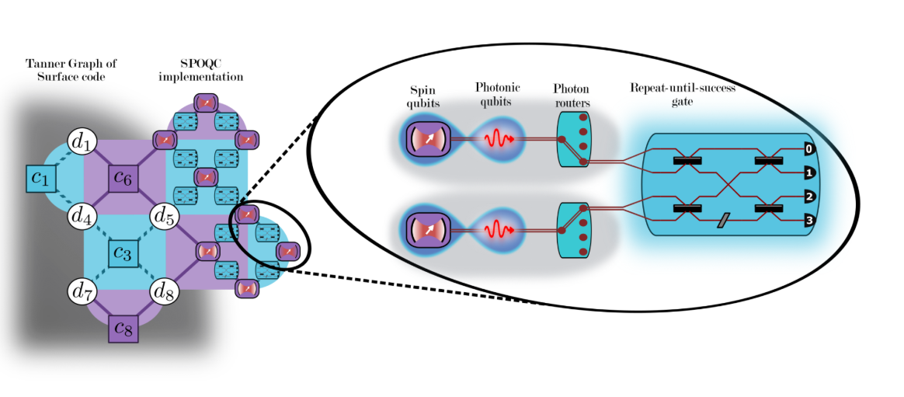
Implementation on a real system?
Hybrid strategies (spin + photon) to facilitate FTQC
https://quantum-journal.org/papers/q-2024-07-24-1423/
My work at Quandela…
But I won’t talk about it

Slide 50
That’s all for quantum error correction! Questions?

Slide 51
Link with photonics?

Slide 52
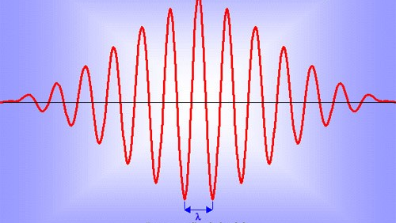
Advantage of photonics
Photonic quantum computing
Photons as quantum information carriers:
Easy, efficient, and fast single-photon operation.
Decoherence free, can store information for arbitrary long time.
Travel at the speed of light.
Other paradigms of quantum computing (boson-sampling like algorithms)
No deterministic two qubit gates / only probabilistic ones
Photons can be lost.
Detector
$$η_{d}$$
Quantum error correction with graph states:
No two-qubit gate required only measurements on graph.
Offline generation of photonic graph states
$$η=η_{s}{η_{t}η}_{d}$$

Slide 53
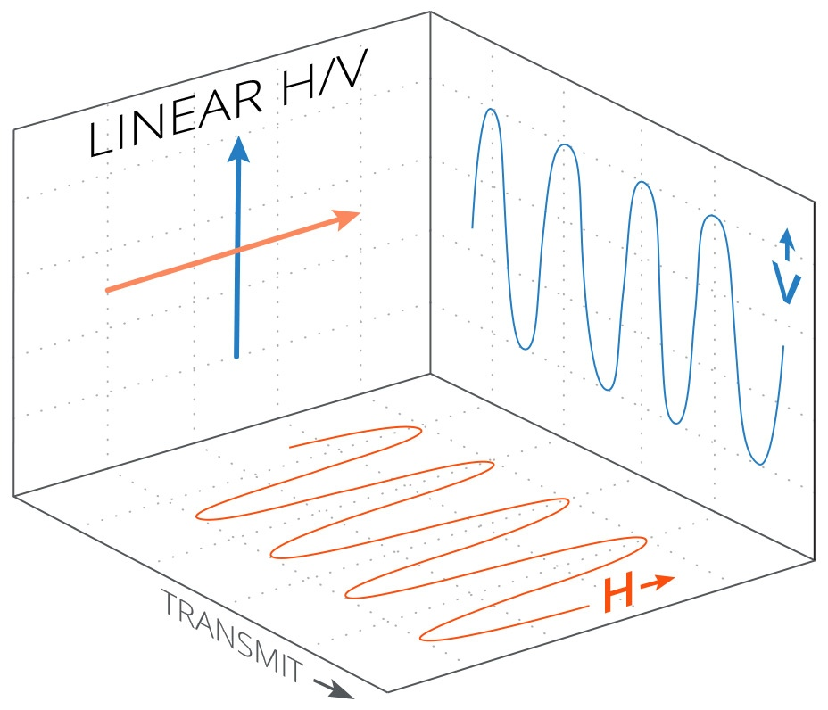
Dual-rail encoding
Photonic quantum computing
Defining a photonic qubit:
Dual-rail encoding (2 modes for 1 photon)
$$|0⟩$$
Detector
$$η_{d}$$
$$|1⟩$$
$$η=η_{s}{η_{t}η}_{d}$$
Path encoding
Polarization encoding

Slide 54
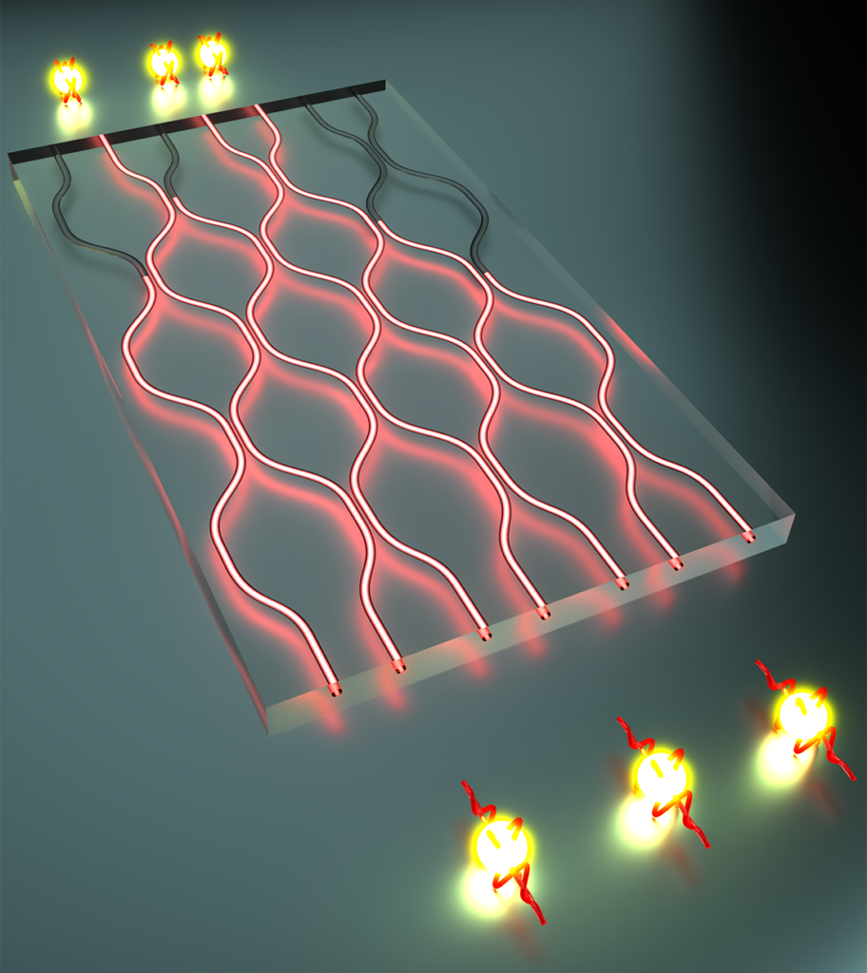
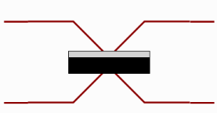
Entanglement with linear optics
Photonic quantum computing
$$\vec{b}={\left(b_{1}, b_{2}, …, b_{m}\right)}^{T}=U \vec{a}=U{\left(a_{1}, a_{2}, …, a_{m}\right)}^{T}$$
$$a_{1}$$
$$b_{1}$$
U
$$a_{2}$$
$$b_{2}$$
…
…
$$a_{m}$$
$$b_{m}$$
Detector
$$η_{d}$$
$$|1⟩$$
Cannot be in the qubit subspace
Intuition why no deterministic 2-qubit gates
$$\left|2,0\right\rangle −|0, 2⟩$$
$$η=η_{s}{η_{t}η}_{d}$$
$$|1⟩$$

Slide 55
Fusion gates
Photonic quantum computing
Focusing on a specific class of photonic gates: fusion gates
Type I fusion gates (take 2 photons and output one photon)
Detectors
Photonic qubit 1
Detector
50-50 Beamsplitter
$$η_{d}$$
Photonic qubit 2
$$η=η_{s}{η_{t}η}_{d}$$
Swap

Slide 56
Fusion gates
Photonic quantum computing
$$F_{I}= |0⟩⟨00|…$$
Detectors
Photonic qubit 1
Photon detection
Detector
50-50 Beamsplitter
$$η_{d}$$
Photonic qubit 2
$$η=η_{s}{η_{t}η}_{d}$$
Swap

Slide 57
Fusion gates
Photonic quantum computing
$$F_{I}= \left|0\right\rangle \left\langle 00\right|+e^{iφ}|1⟩⟨11|…$$
Detectors
Photonic qubit 1
Photon detection
Detector
50-50 Beamsplitter
$$η_{d}$$
Photonic qubit 2
$$η=η_{s}{η_{t}η}_{d}$$
Swap

Slide 58
Fusion gates
Photonic quantum computing
$$F_{I}= \left|0\right\rangle \left\langle 00\right|+e^{iφ}|1⟩⟨11|…$$
$$Fail=|∅⟩⟨01|$$
Detectors
Photonic qubit 1
Photon detection
Detector
50-50 Beamsplitter
$$η_{d}$$
Photonic qubit 1
$$η=η_{s}{η_{t}η}_{d}$$
Swap

Slide 59
Fusion gates
Photonic quantum computing
$$F_{I}= \left|0\right\rangle \left\langle 00\right|+e^{iφ}|1⟩⟨11|…$$
$$Fail=|∅⟩⟨01|,$$
$$Fail_{2}=|2⟩⟨10|$$
Detectors
Photonic qubit 1
Photon detection
Detector
50-50 Beamsplitter
$$η_{d}$$
Photonic qubit 1
$$η=η_{s}{η_{t}η}_{d}$$
Swap

Slide 60
Fusion gates
Photonic quantum computing
In practice this gate takes 2 photons and output one
$F_{I}= \left|0\right\rangle \left\langle 00\right|+{\left(−1\right)}^{m}\left|1\right\rangle \left\langle 11\right|$ ($m$ detector)
Postselect on successful outcome. $P_{success}=\frac{1}{2}$
Detectors
Photonic qubit 1
Photon detection
Detector
50-50 Beamsplitter
$$η_{d}$$
Photonic qubit 1
$$η=η_{s}{η_{t}η}_{d}$$
Swap

Slide 61
Fusion gates
Photonic quantum computing
In practice this gate takes 2 photons and output one
$P_{success}=\frac{1}{2}$
Detectors
Photonic qubit 1
50-50 Beamsplitter
Photonic qubit 1
$$π$$
Swap
$F_{I}= \left|0\right\rangle \left\langle 00\right|+\left|1\right\rangle \left\langle 11\right|$

Slide 62
Stabilizer states and tree graph codes: The graph states

Slide 63
Partial solution: measurement-based quantum computing
A method to perform QC without the need of two-qubit gates (provided that you have a large entangled resource state…)
$$\left|G=\left(E, V\right)\right\rangle$$
$E$ edge set
(entanglement link $CZ$)
$V$ vertex set
(qubits $\left|+\right\rangle$)
$$CZ=\left(\begin{matrix}\begin{matrix}1 & 0 \\ 0 & 1\end{matrix} & \begin{matrix}0 & 0 \\ 0 & 0\end{matrix} \\ \begin{matrix}0 & 0 \\ 0 & 0\end{matrix} & \begin{matrix}1 & 0 \\ 0 & −1\end{matrix}\end{matrix}\right)$$
Detector
$$η_{d}$$
$$η=η_{s}{η_{t}η}_{d}$$
R. Raussendorf & HJ. Briegel, PRL 86, 9188 (2001)

Slide 64
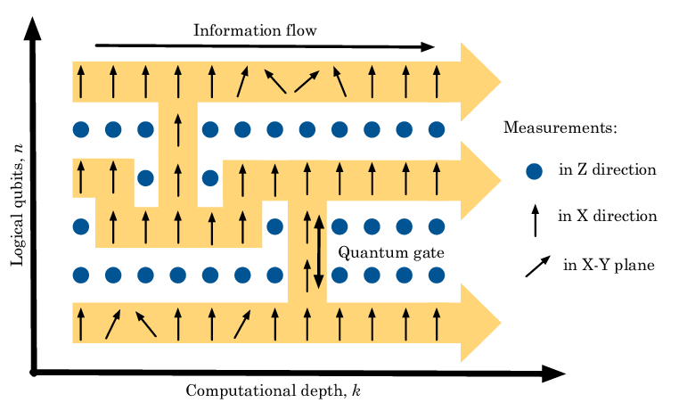
Partial solution: measurement-based quantum computing
A method to perform QC without the need of two-qubit gates (provided that you have a large entangled resource state…)
$$\left|G=\left(E, V\right)\right\rangle$$
$E$ edge set
(entanglement link $CZ$)
$V$ vertex set
(qubits $\left|+\right\rangle$)
$$K_{v}\left|G\right\rangle =\left|G\right\rangle$$
$$K_{v}=X_{v}\prod_{\left(v,w\right)∈E}{Z_{w}}$$
Detector
$$η_{d}$$
$$η=η_{s}{η_{t}η}_{d}$$
R. Raussendorf & HJ. Briegel, PRL 86, 9188 (2001)

Slide 65
Measurement-based QEC with tree graph codes
MBQEC
$$\left|G=\left(E, V\right)\right\rangle =\left(\prod_{\left(i,j\right)∈E}{CZ_{ij}}\right){\left|+\right\rangle }^{⊗v∈V}$$
Perfectly defined state.
(no qubit degree of freedom) A lot of stabilizers
$$∀v∈V, K_{v}=X_{v}\prod_{(v,w)∈E}{Z_{w}}$$
Detector
$$η_{d}$$
$$η=η_{s}{η_{t}η}_{d}$$

Slide 66
Measurement-based QEC with tree graph codes
MBQEC
Create a tree code, remove the top qubit (and it’s related stabilizers)
Create a qubit degree of freedom:
$$X_{L}=X ZZZ$$
$$Z_{L}=ZZZ$$
Detector
$$η_{d}$$
$$η=η_{s}{η_{t}η}_{d}$$

Slide 67
Measurement-based QEC with tree graph codes
MBQEC
How does it work. Suppose that you want to measure the logical $Z_{L}$ operator. You can directly measure its qubits…
But you can also indirectly measure them using the stabilizers!
$$X$$
Detector
$$Z$$
$$Z$$
$$Z$$
$$η_{d}$$
$$K_{v}\left|ψ\right\rangle =|ψ⟩$$
$$K_{v}=Z_{v_{0}}X_{v}\prod_{\begin{aligned}\left(v,w\right)∈E \\ w≠v_{0}\end{aligned}}{Z_{w}}$$
$$Z_{v_{0}}\left|ψ\right\rangle =X_{v}\prod_{\begin{aligned}\left(v,w\right)∈E \\ w≠v_{0}\end{aligned}}{Z_{w}}|ψ⟩$$
$$η=η_{s}{η_{t}η}_{d}$$

Slide 68
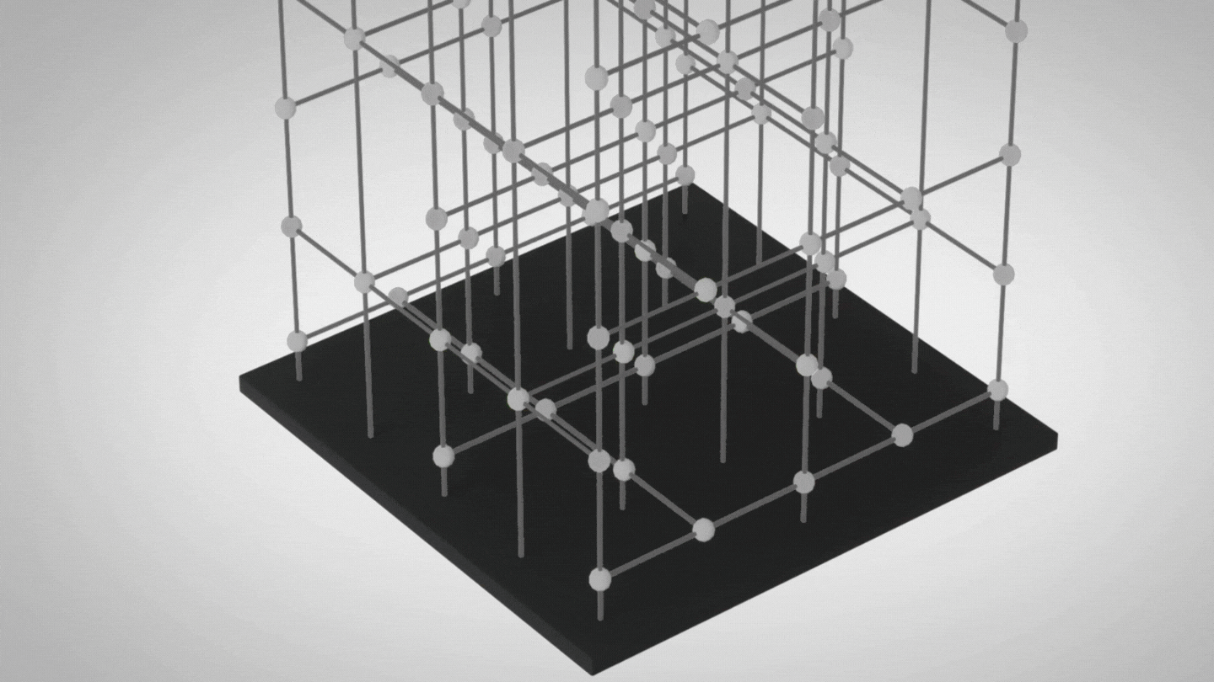
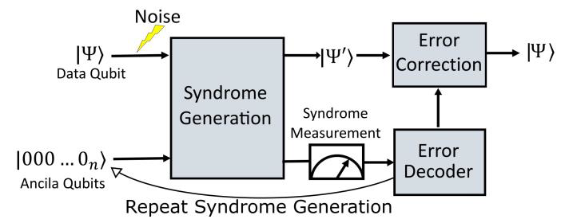
Measurement-based QEC
MBQEC
Detector
$$η_{d}$$
Credit: Xanadu
$$η=η_{s}{η_{t}η}_{d}$$
In practice, tree graphs are too simplistic, 3D lattices are the real deal!
How to generate a large graph state without deterministic gates?

Slide 69
Fusion gates
Photonic quantum computing
Why this gate?
It combines well with graph states
It fuses the vertex of the two graphs
You can create larger entangled state from smaller ones
Type I gate

Slide 70
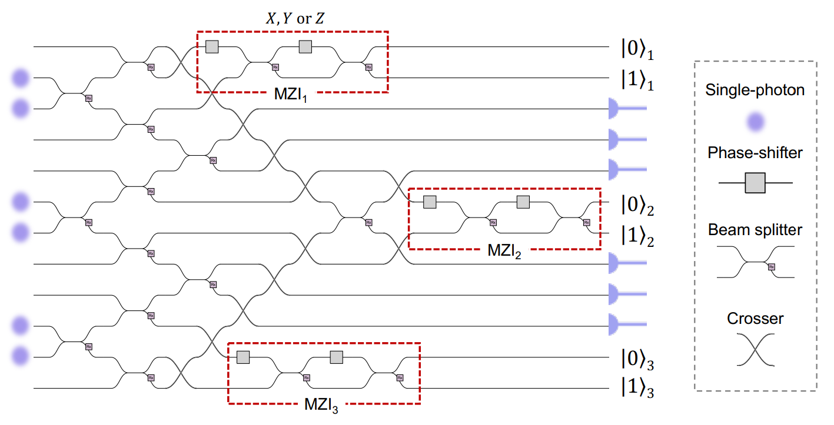
Small entangled state generation
Photonic quantum computing
We also need to produce small entangled state.
Solution 1: Linear-optics.
Create a photonic GHZ state:
$\left|000\right\rangle +\left|111\right\rangle$
Requires 6 photons
Ouputs 3 entangled photons
Based on detection outcomes
Success probability 1/32…

Slide 71
Small entangled state generation
Photonic quantum computing
We also need to produce small entangled state.
Solution 2: Deterministic generation through quantum emitters.
Entangled source of photons
Use a spin degree of freedom as a photon entangler
Create photonic GHZ and linear graph states
N. Coste et al., Nat. Photon. 17, 582 (2023)

Slide 72
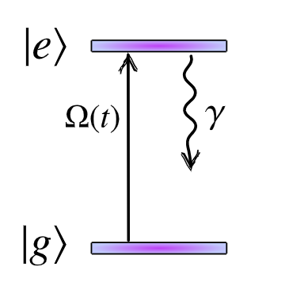
Small entangled state generation
Photonic quantum computing
Optical transitions:
Two level system:
Excite optically with a laser the ground state $(Ω\left(t\right))$
The quantum emitter is in the excited state $|e⟩$
The quantum emitter relaxes its energy by emitting a single photon (in a time $T_{1}$, called the relaxation time).
After $t≫T_{1}$, the quantum emitter is in the ground state $|g⟩$ and a single photon has been deterministically generated.

Slide 73
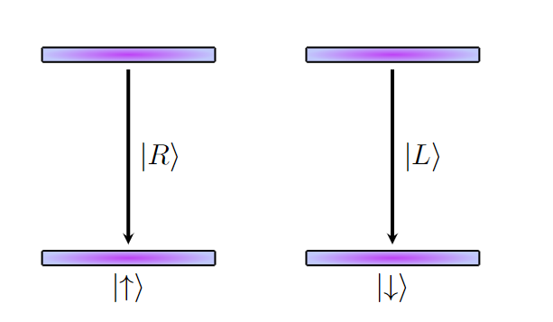
Small entangled state generation
Photonic quantum computing
Optical transitions:
Four-level system:
The spin is in a given initial state
$$\left|ψ_{s}\right\rangle =α\left|↑\right\rangle +β\left|↓\right\rangle$$
With a laser, put it in the two excited state.
After spontaneous emission, a photon is emitted with spin-dependent polarization
$$\left|ψ_{s,ph}\right\rangle =α\left|↑, R\right\rangle +β\left|↓, L\right\rangle$$
Spin-dependent transitions polarization
Stable spin degree of freedom

Slide 74
Small entangled state generation
Photonic quantum computing
Optical transitions:
$$\left|+\right\rangle =\left|↑\right\rangle +\left|↓\right\rangle$$
After first emission
$$\left|ψ_{s, ph}\right\rangle =α\left|↑, R\right\rangle +β\left|↓, L\right\rangle$$
Second emission:
$$\left|ψ_{s}\right\rangle =α\left|↑, R,R\right\rangle +β\left|↓, L,L\right\rangle$$
$n^{th}$ emission:
$$\left|ψ_{s,ph}\right\rangle =\left|↑\right\rangle {\left|R\right\rangle }^{⊗n}+\left|↓\right\rangle {\left|L\right\rangle }^{⊗n}$$
$$\left|ψ_{s,ph}\right\rangle =\left|0\right\rangle {\left|0\right\rangle }^{⊗n}+\left|1\right\rangle {\left|1\right\rangle }^{⊗n}$$
We can create a GHZ state deterministically
Spin-dependent transitions polarization
Stable spin degree of freedom

Slide 75
Small entangled state generation
Photonic quantum computing
Optical transitions:
$$\left|ψ_{s,ph}\right\rangle ={\left|0\right\rangle }^{⊗n}+{\left|1\right\rangle }^{⊗n}$$
$$=$$
(up to single-qubit rotations)
Spin-dependent transitions polarization
This star graph state is in fact
$$\left|0\right\rangle {\left|+\right\rangle }^{⊗n−1}+\left|1\right\rangle {\left|−\right\rangle }^{⊗n−1}$$
Stable spin degree of freedom

Slide 76
Advanced graph state generation
Combining fusions and small entangled state generation
Successful

Slide 77
Advanced graph state generation
Combining fusions and small entangled state generation
Z
Z
Z
Z
Failure
Failure

Slide 78
Advanced graph state generation
Combining fusions and small entangled state generation
Recycling idea

Slide 79
Fusion-based
quantum computing

Slide 80
Fusion based-quantum computing
Mixing MBQC + probabilistic photonic gates
General intuition #1:
Small entangled states are easier to produce than large ones
If we have a system which can produce a graph with success proba $p_{G}$…
…We can use $N$ of these systems to produce, to produce at least 1 graph with proba $1 −{\left(1 −p_{G}\right)}^{N} \overset{→}{N→∞} 1$
We can build a resource state generator which produce a small graph with arbitrarily high probability
Detector
$$η_{d}$$
RSG
$$η=η_{s}{η_{t}η}_{d}$$

Slide 81
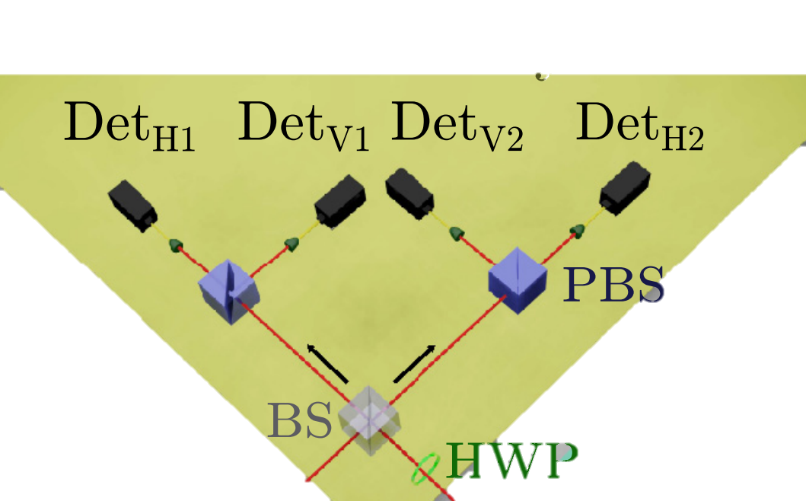
Fusion based-quantum computing
Mixing MBQC + probabilistic photonic gates
General intuition #2:
Quantum gates have smaller success rate than fusion gates
Fusion gates can have arbitrarily large success probability (provided ancilla use)
Replace CNOT gates by fusion gates (BSM)
Detector
F
$$η_{d}$$
$$η=η_{s}{η_{t}η}_{d}$$

Slide 82
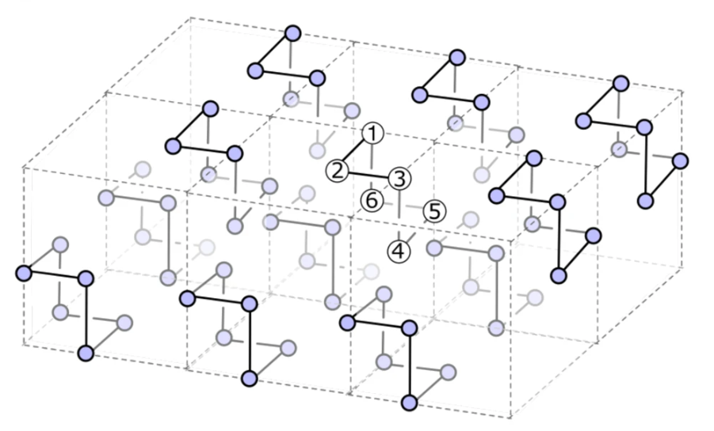
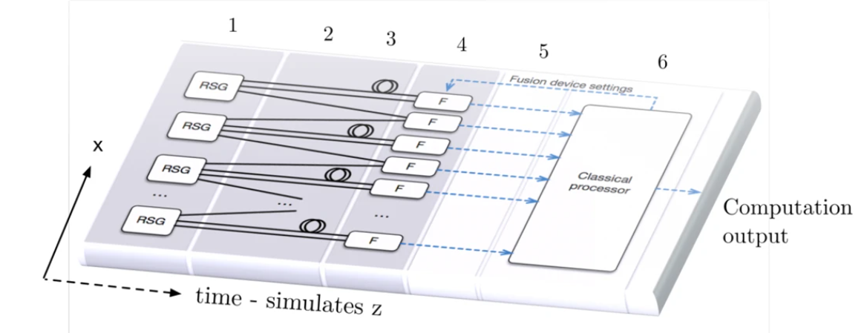
Fusion based-quantum computing
Mixing MBQC + probabilistic photonic gates

Slide 83
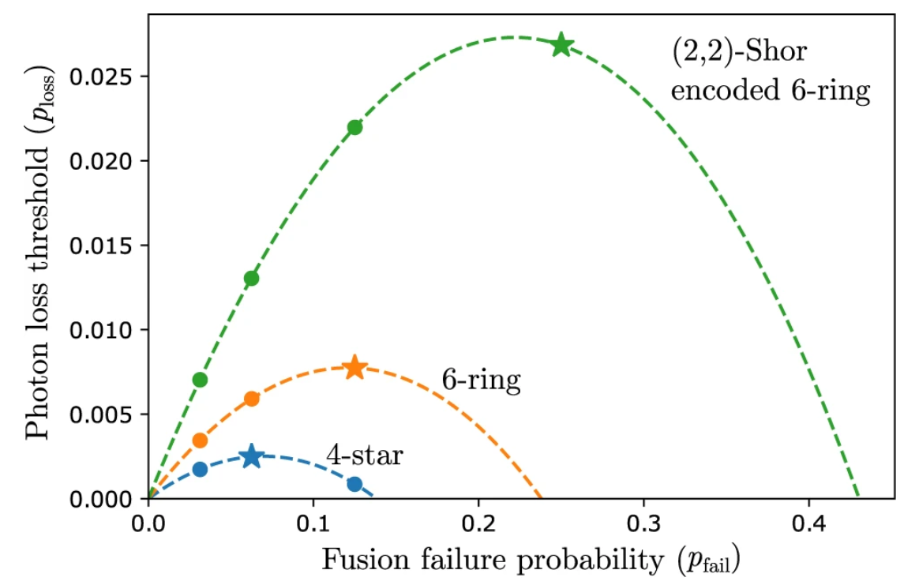
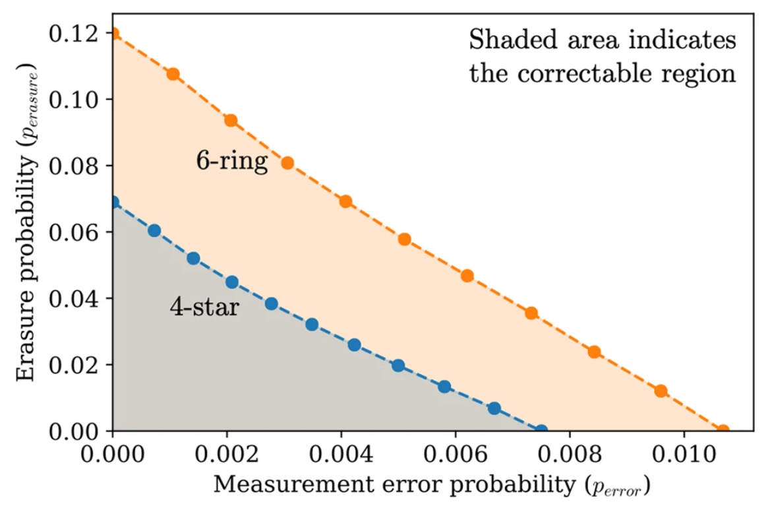
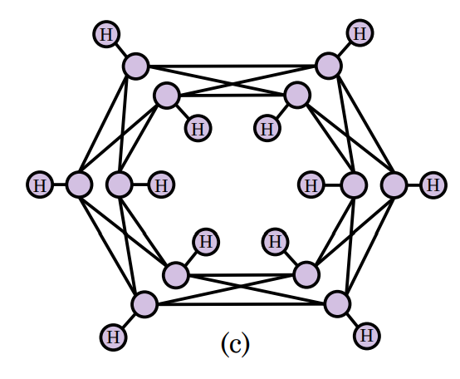
Fusion-based quantum computing
Performances
Loss probability
of a fusion gate
Detector
$$1−p_{erasure}=\left(1−p_{fail}\right){\left(1−p_{loss}\right)}^{n}$$
$$η_{d}$$
Computational error probability
of a fusion gate
$$η=η_{s}{η_{t}η}_{d}$$
(2,2)-Shor encoded
6-ring

Slide 84
Conclusion

Slide 85
What have we seen?
Introduction about quantum error correction:
Need to correct blitflips and phaseflips
An introduction to the stabilizer formalism (the main framework for QEC)
Syndrome extraction in QEC (with circuit-based paradigm)
Introduction to graph state codes:
Codes particularly well suited for measurement-based QEC (photonics friendly!)
Basic error correction schemes with trees.
Detector
$$η_{d}$$
$$η=η_{s}{η_{t}η}_{d}$$

Slide 86
What have we seen?
Photonic ingredients to produce graph codes.
Simple fusion gates
Small graph state generation through linear-optics
Small graph state generation using quantum emitters
A brief introduction about more advanced schemes
Fusion-based quantum computing
Detector
$$η_{d}$$
$$η=η_{s}{η_{t}η}_{d}$$

Slide 87
Disclaimer
The field of fault-tolerant quantum computing is vast! This lecture is only an introduction.
What I haven’t discuss here
Quantum error correction is a very active field with recent important discoveries:
“Standard” codes like the surface codes
“Good” quantum error correcting codes (quantum Low-Density Parity Check codes)
Quantum error correction circuits
Decoding a code is a critical problem too, not trivial at all.
Minimum-Weight Perfect Matching / Union Find decoders
https://www.youtube.com/watch?v=tNACODva-6A

Slide 88
Disclaimer
What I haven’t discuss here (follow up)
Performing fault-tolerant gates on logically-encoded qubits
Eastin-Knill theorem
Lattice surgery / Magic state distillation
Conversion from QEC to graph states
MBQC
Foliation technique
The 3D “Raussendorf Harrington Goyal” lattice
Advanced photonic gates for graph state generation
Ancilla-photon-assisted gates
Deep connections with quantum information theory
https://www.youtube.com/watch?v=zBjAoOW3xHk
Detector
https://journals.aps.org/prl/abstract/10.1103/PhysRevLett.117.070501
$$η_{d}$$
$$η=η_{s}{η_{t}η}_{d}$$

Slide 89
Thank you

